Slide 1
APPLICATION OF SOLUTION OF ALGEBRAIC AND TRANSCENDENTAL EQUATION.

Slide 2
Introduction Outline.
1.
Equation
2.
Types
3.
General Application

Slide 3
I’m Md. Hafizur Rahman Arfin
ID: 161-15-7144

Slide 4
1.
Equation
What is an equation?

Slide 5

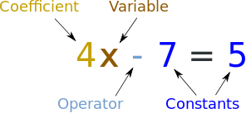
An equation says that two things are equal. It will have an equals sign "=".
That equation says: what is on the left (4x - 7) is equal to what is on the right (5)
So an equation is like a statement "this equals that"

Slide 6

EQATIONS ARE LIKE SCALES WITH EQUAL WEIGHT.

Slide 7
2.
Types
How many types equation are there?

Slide 8
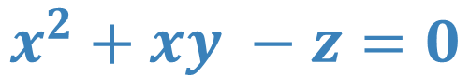
Equation types.
1. Algebric: An equation in the form of a polynomial having a finite number of terms and equated to zero
$$x^{2}+xy −z=0$$

Slide 9
Equation types.
2. Transendental: Transcendental equations are equations containing transcendental functions, i.e. functions which are not algebraic. An algebraic function is a function that satisfies a polynomial equation whose terms are themselves polynomials with rational coefficients.
$$e^{x}+2\sin\left(x\right)−5x=0$$

Slide 10
3.
General Application
Usage of solution of equation in computer science.

Slide 11
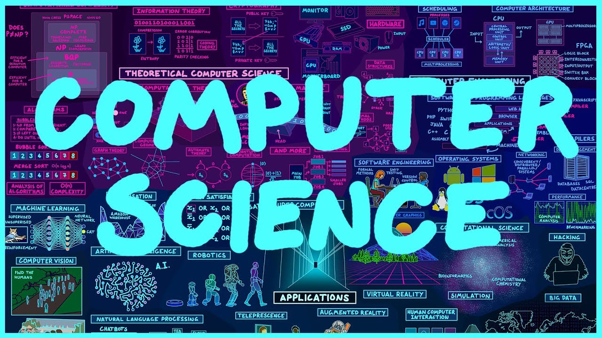

Slide 12

General Use of solution of equation in computer science.
Colors in monitor.
Memory Management.
Image processing.
Machine Learning.
Artificial Intelligence.
Digital Maps.
Self Driving Cars.
Computer Graphics.

Slide 13
Thanks!
Any questions?

